Slide 1
MIS 407
w01c03
Prof. Smith

Slide 2
Recap
Last class we reviewed terminal/command line interfaces, and the 8+1 basic commands (I added cd to the list)
You’ve submitted your first ICA (marks have been posted).
You should have read section 1.1 through 1.3 of the ProGit online book
https://git-scm.com/book/en/v2

Slide 3
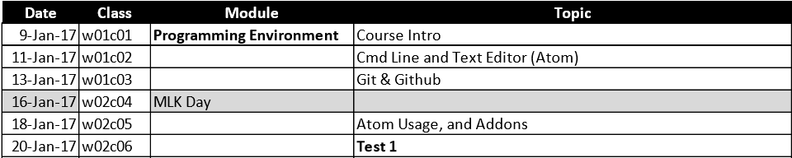
For Today…
Goals:
Introduce Git and and GitHub
Conduct our second in-class assignment ICA02

Slide 4
Intro to Git
Git is a VCS (version control system).
Most large, multi-member, group projects will use some form of VCS
Git is one of the most popular.

Slide 5
History of Git
Developed by Linus Torvalds (Linux Fame)
He wasn’t happy with existing VCS’s
They had a number of problems, and were generally slow and cumbersome.
He hated existing VCS so much that he didn’t even use them in his Linux Kernel project
He used tar-balls and patches – a rather “manual” method.

Slide 6
Why Git
Our projects really won’t be that large, so why use Git?
Group work requires complex coordination of updates and code, Git helps make this “safer”
The power of “versioning” and “branching”
MOST importantly, it’s a key means through which to participate in a programming community.
See 7:13 onward of … https://www.youtube.com/watch?v=Vo9KPk-gqKk

Slide 7
Intro Concepts
A “repo” is a repository of your code who’s state is managed by Git.
Files are tracked, untracked, or ignored.
There are multiple Git clients out there, we will use the official release from
www.git-scm.com.
NOTE: We will only be using the command land version. Knowing the command line version will allow you to more fully understand and control Git.

Slide 8
General Process
Initialize a repo (later, you’ll usually clone one from GitHub)
Add and commit files to the repos.
Modify files in the repos, stage them, and them commit them back into the repo.

Slide 9
The four “states” of a change to files in your repo
1. Untracked
A file that has never been committed to the repo and is not staged.
2. Unmodified
A file that has been previously committed to the repos (thus, it is tracked) but no changes to the file have been made since the last commit.
3. Modified
A file that is being tracked, and changes have been made to the file since the last commit.
4. Staged
A tracked file that has bee readied to be committed to the repos. You add any modified files to a staging area. The staging area is “built up” and organized until you are ready to commit the changes to the repo.
Committed
This is a state of a file, but is worth nothing here.
Once you “commit” the changes that are staged, the file moves to the Unmodified state.

Slide 10
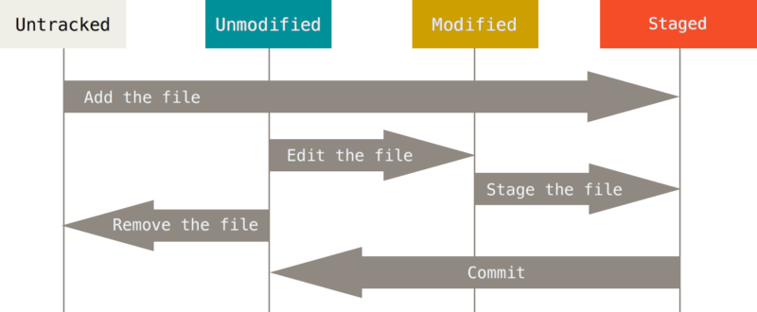
The four possible “states” of a of a file in your repo

Slide 11
Let’s try this…
Got to our GitHub site MIS407-17s
https://github.com/MIS407-17s
Work through the following:
1.git_basic_local_workflow.md

Slide 12
By next class…
First: Review sections 2.1 through 2.5 of ProGit, Chapter 2 “Git Basics”
https://git-scm.com/book/en/v2
During Next class…
Continue with working with/learning Git
Review how to submit an assignment using Git/GitHub.
Quick intro to Atom
Review for first test (challenge).
Hint: It will be a Git/GitHub challenge where you need to accomplish a task using techniques covered and submit a copy of your Bash session (as a text file).

